Slide 1
Home Page and Menu updates
Change all instances of “Gates” into “Communities” on webpage
In database, can keep calling them Gates”

Slide 2

Buy/Sell Create $Metasalt My Stuff
NFTs
$Metasalt
NFTs
Community
Earn
Use
Buy/Sell
NFT Listings
Communities
Brands
Collections
History
Settings
Logout
All Marketplace
Authenticate page
Stays same
Create NFT page
Create Gate page
Uniswap
Create to earn model for NFTs for $metasalt

Slide 3

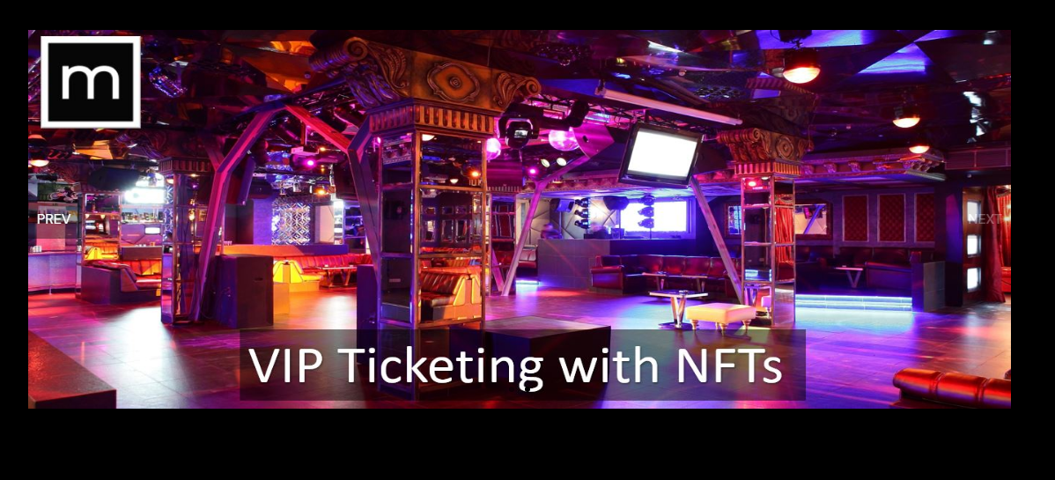
Communities
Add new button on each slider page
Keep this section
Taglines:
Build Communities
Invest in yourself
Authenticate NFTs
Call to Action

Slide 4
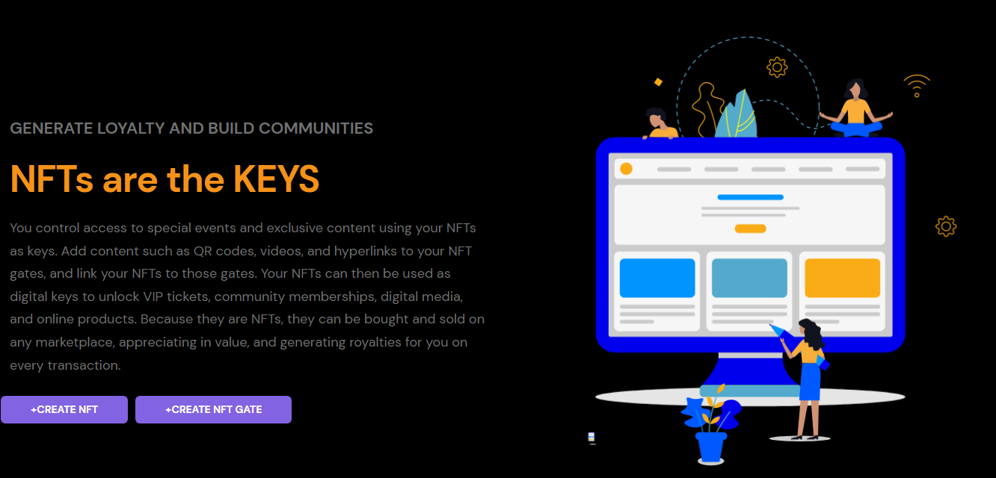
Communities
Move this section
To new page that is linked to
New button on slider page

Slide 5
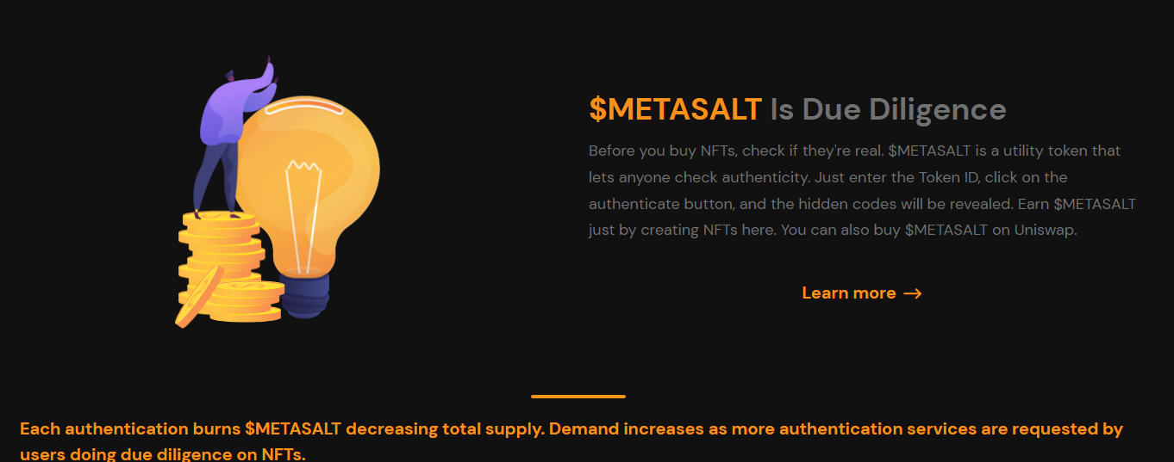
Move this section
To new page that is linked to
New button on slider page
Communities

Slide 6
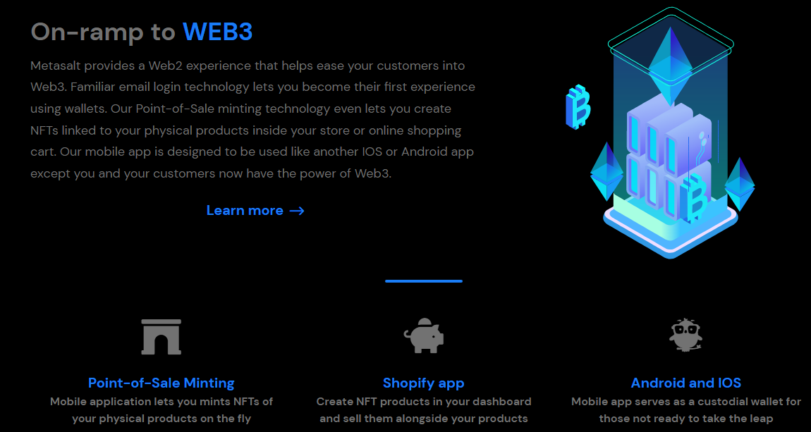
Communities
Move this section
To new page that is linked to
New button on slider page

Slide 7
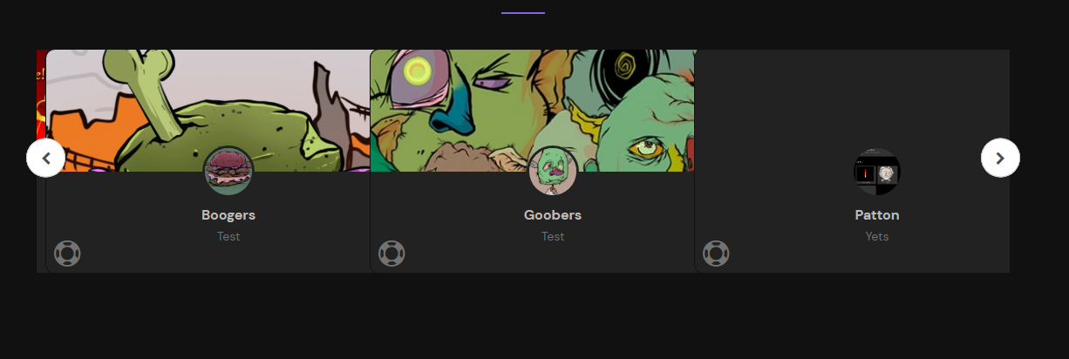
New home page should have following section
Right below the main slider.js
Communities
Popular Communities
Get VIP access to your favorite NFT Artists, Projects, or Brands
Or create your own VIP community!

Slide 8
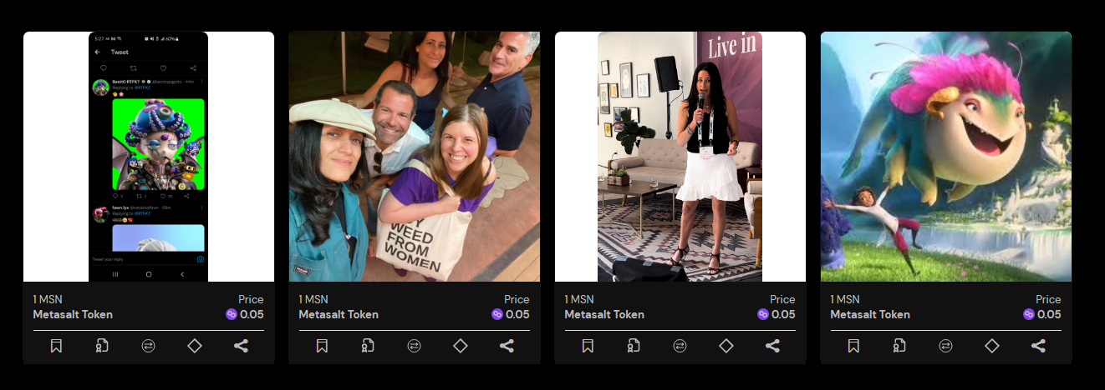
Communities
New home page should have following section
Right below the populargates.js
NFT Marketplace
Buy/Sell your favorite Artist, Project, and Brand
Or create your own NFTs!

Slide 9
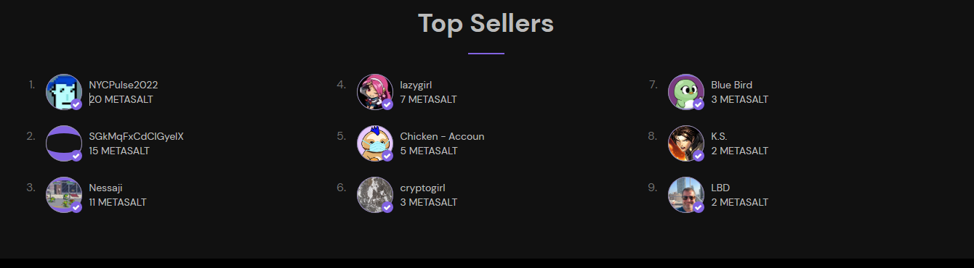
Communities
New home page should have following section
Right below the NFT marketplace. Change Top
Sellers to Active Creators
Active Creators
Explore top NFT artists, projects, and brands

Slide 10
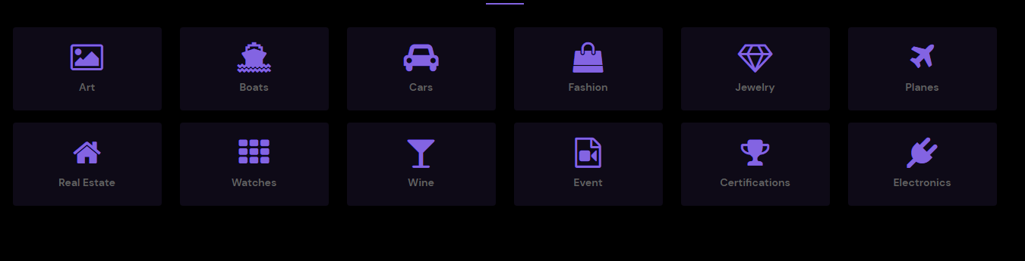
Communities
New home page should have following section
Right below the Active Creators section
Real World NFTs
Find NFTs of physical goods and items
Or create your own

